Slide 1
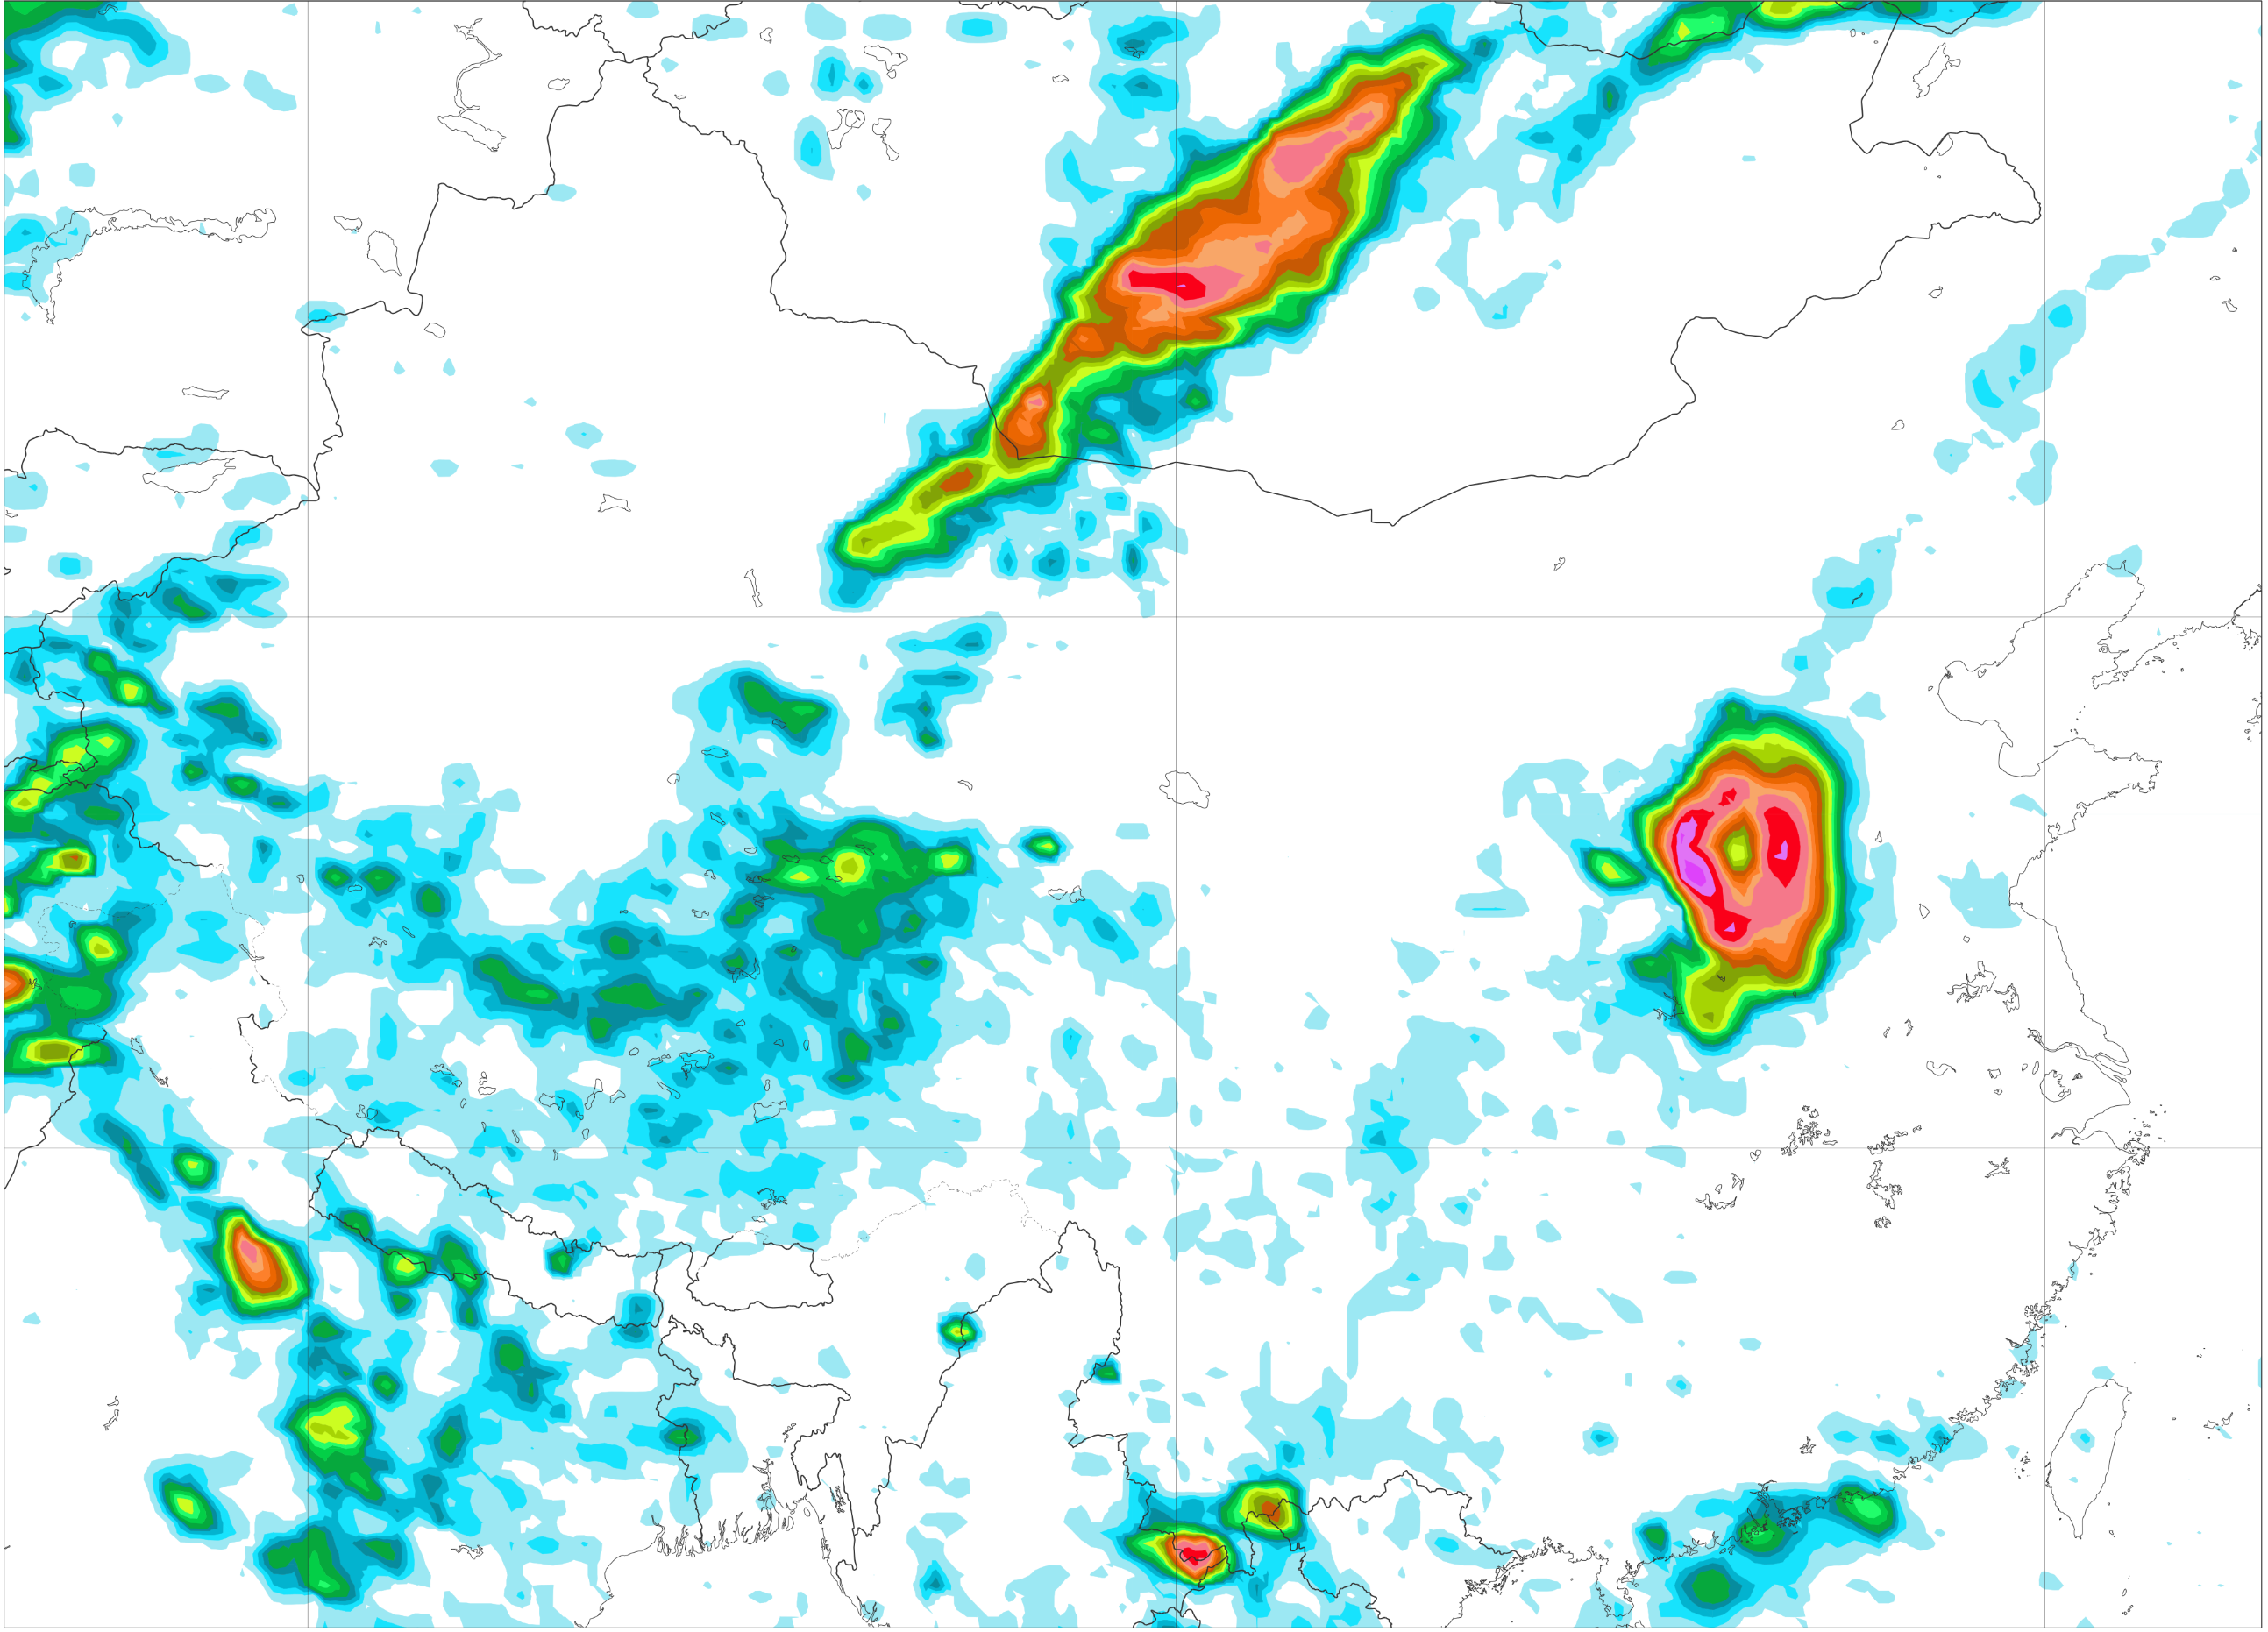
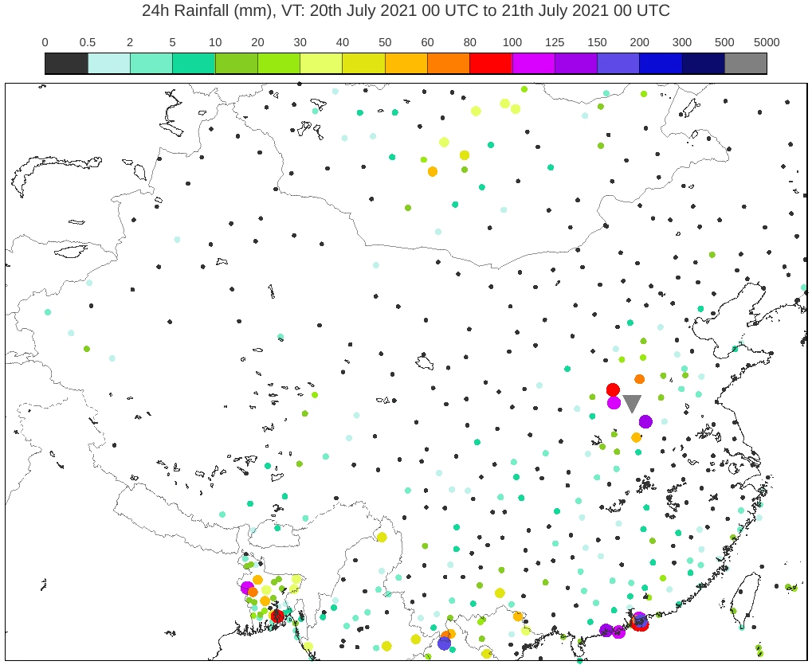
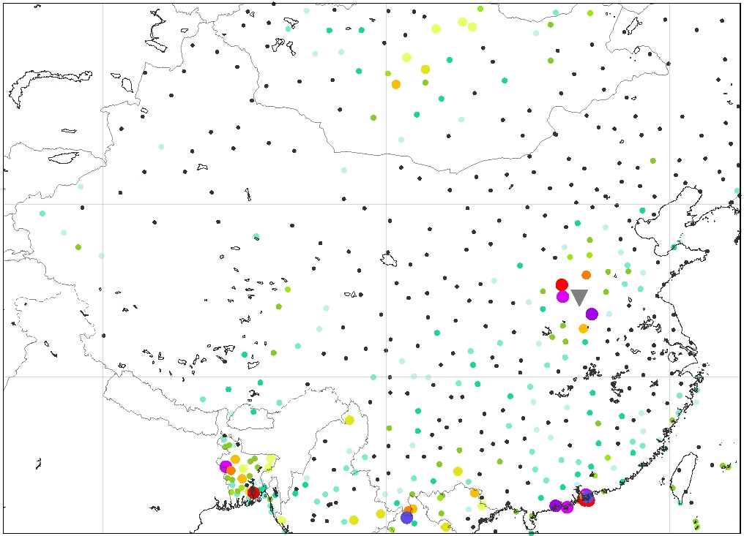

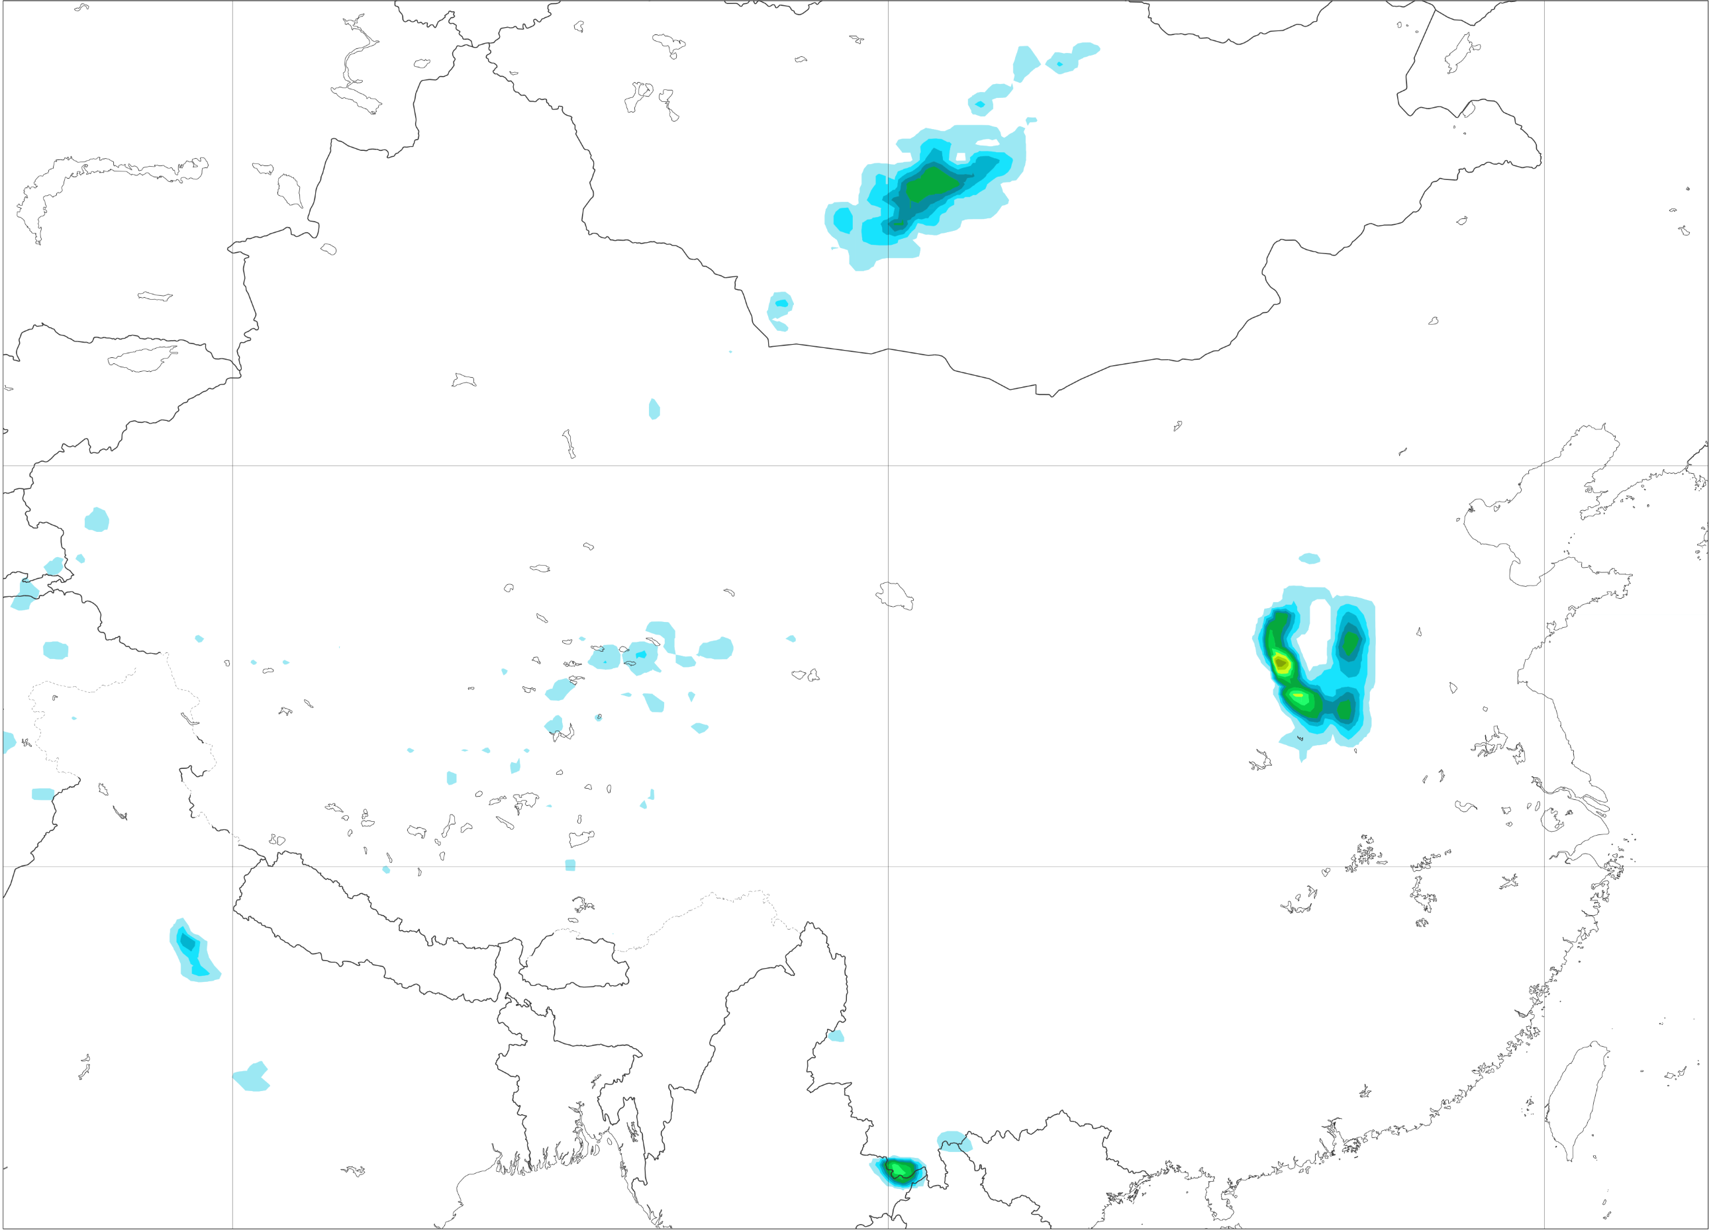
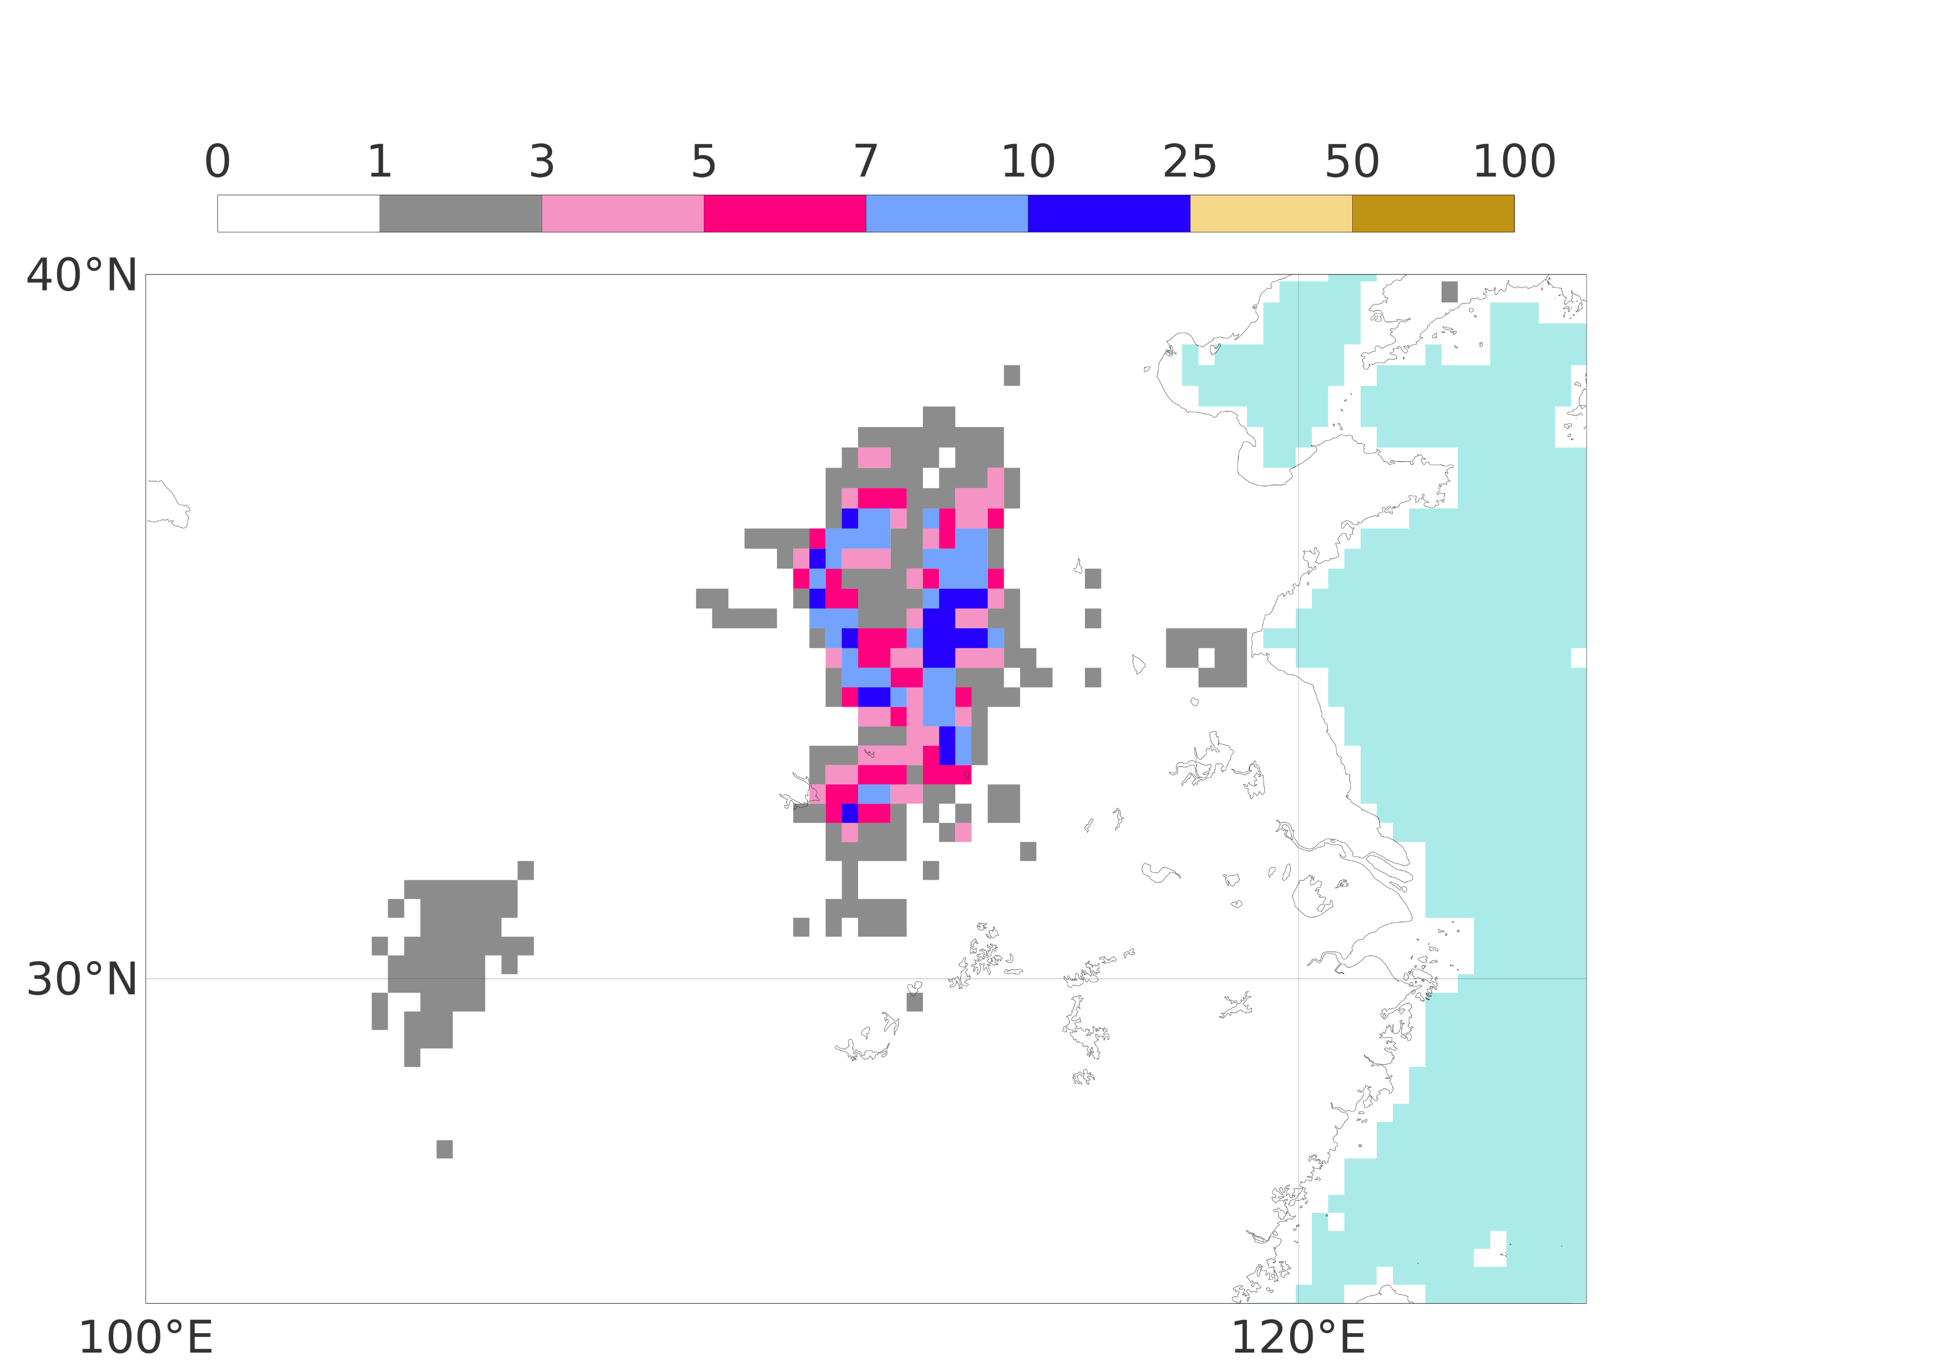
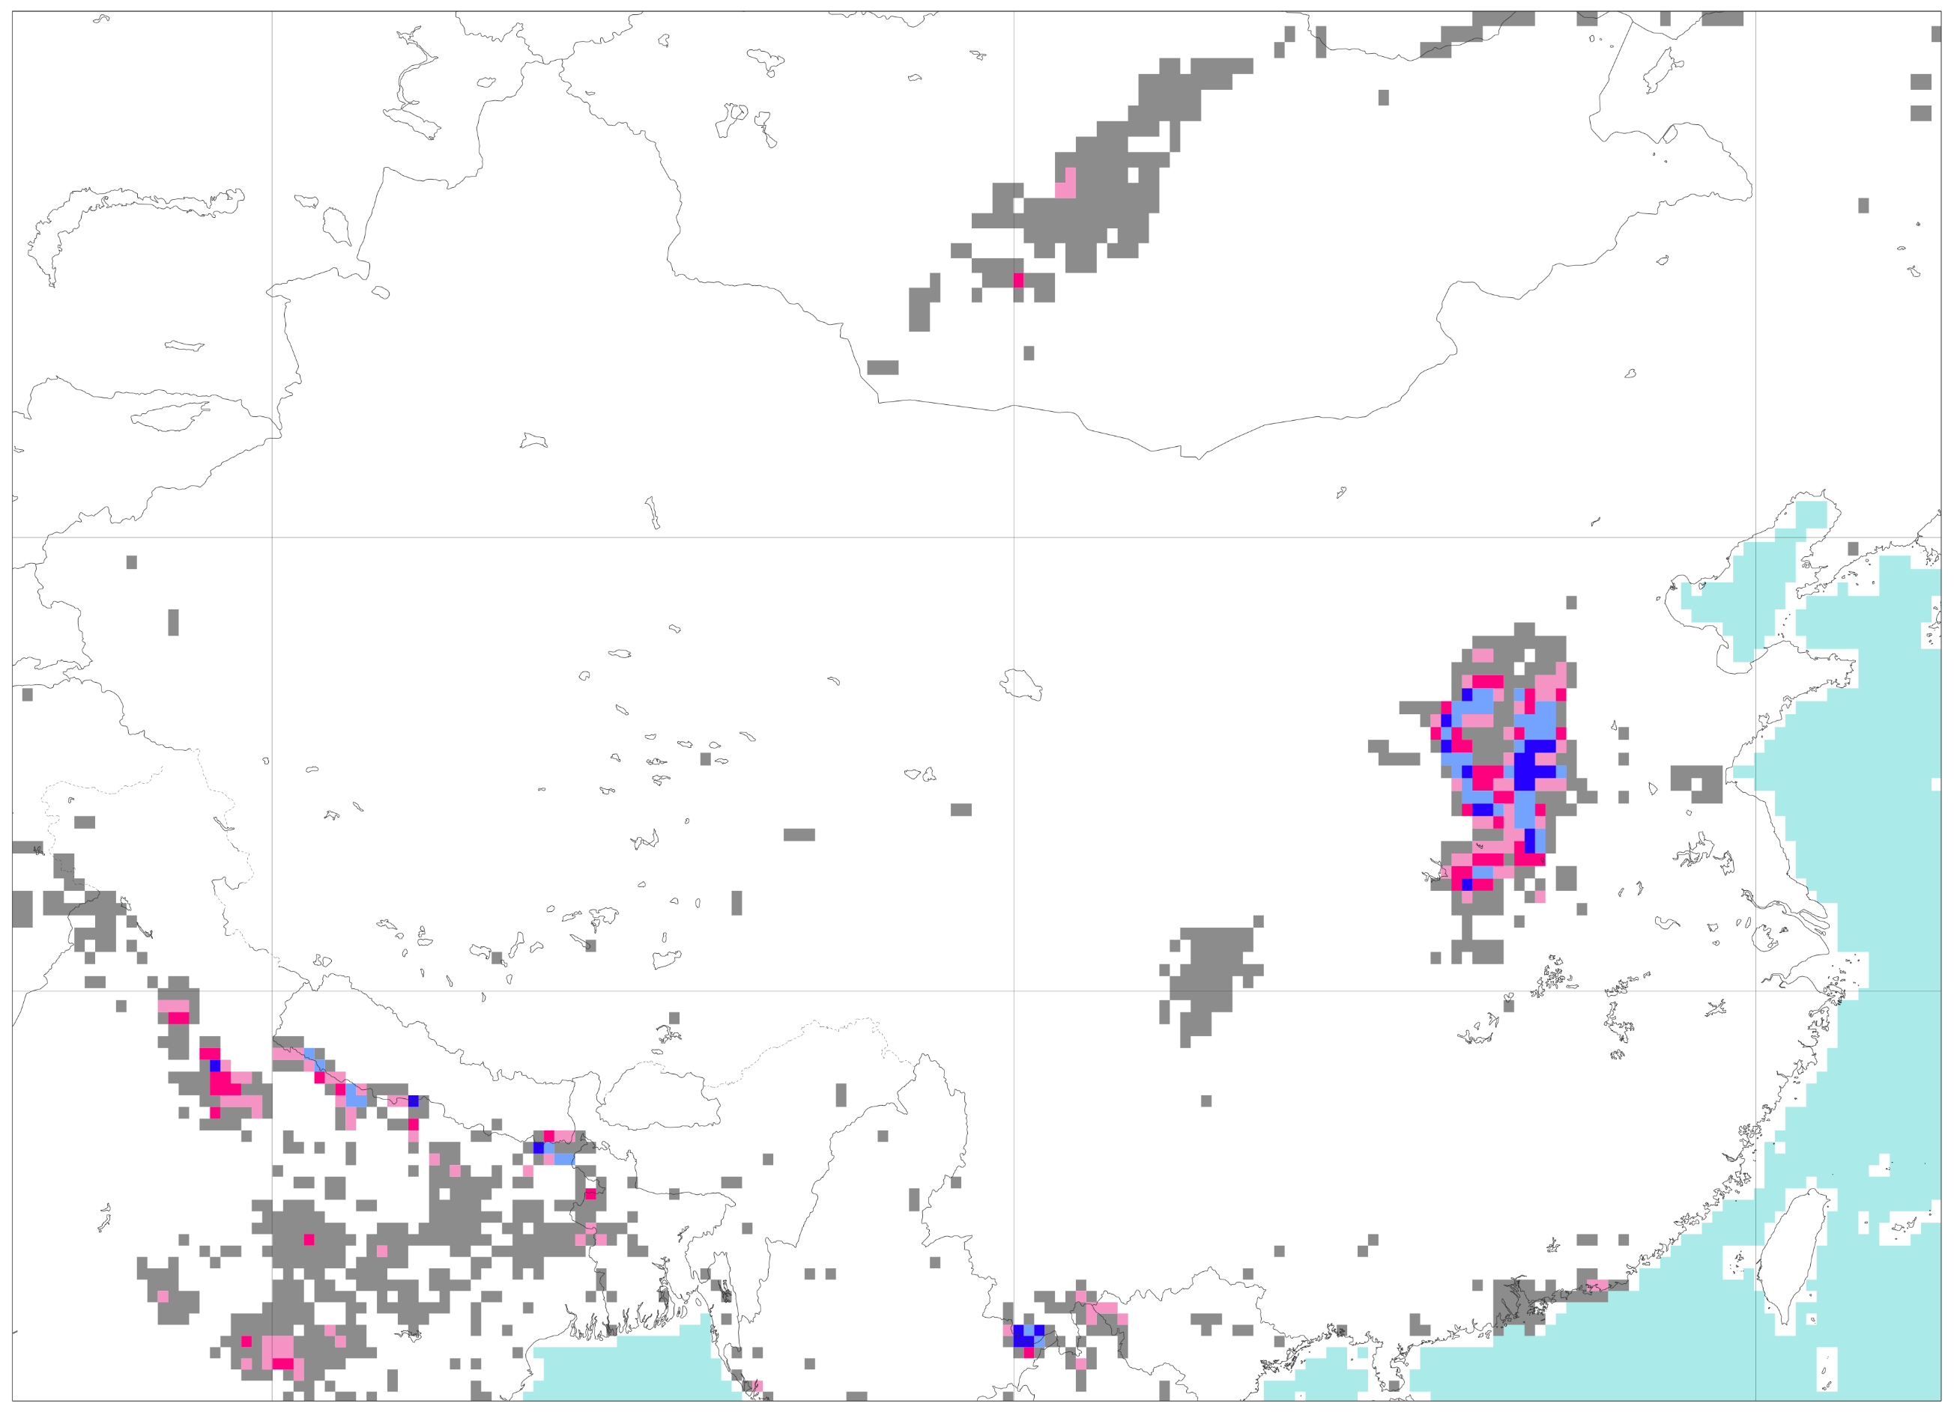
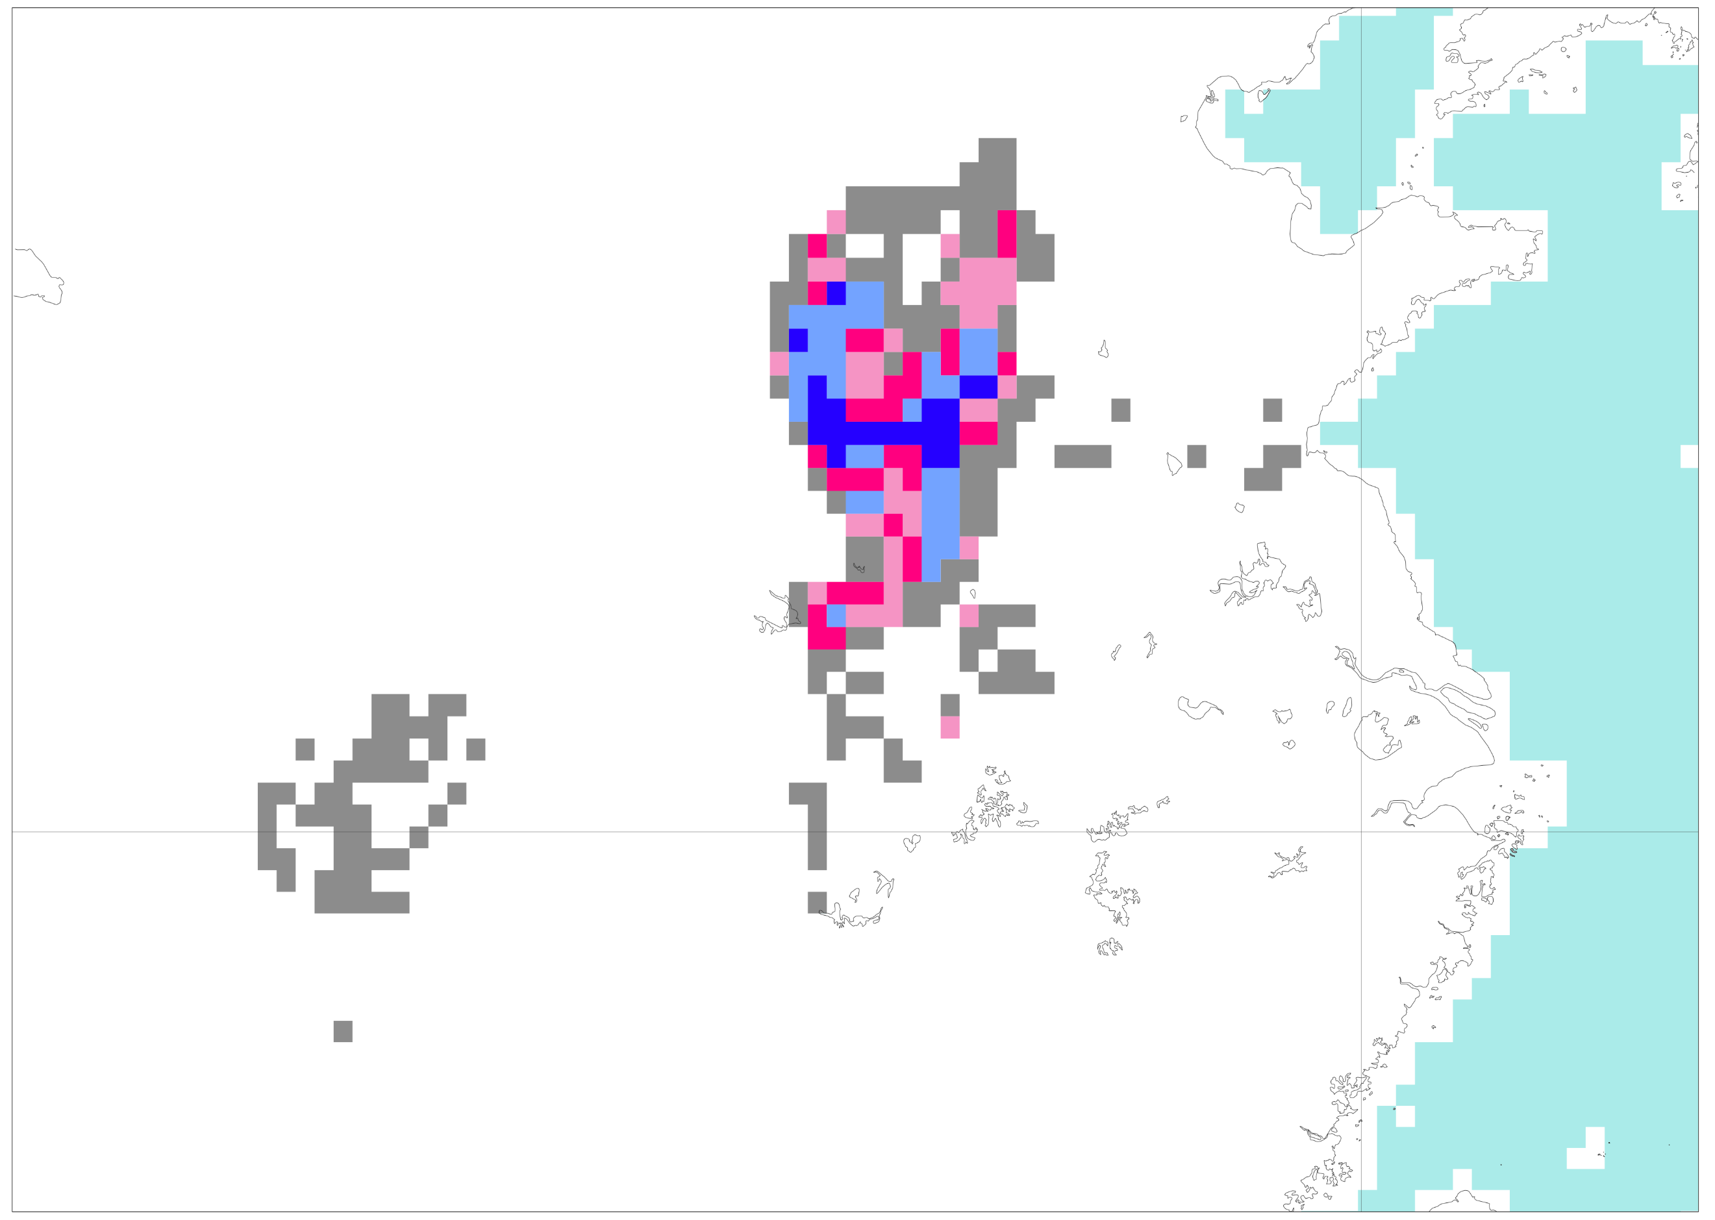
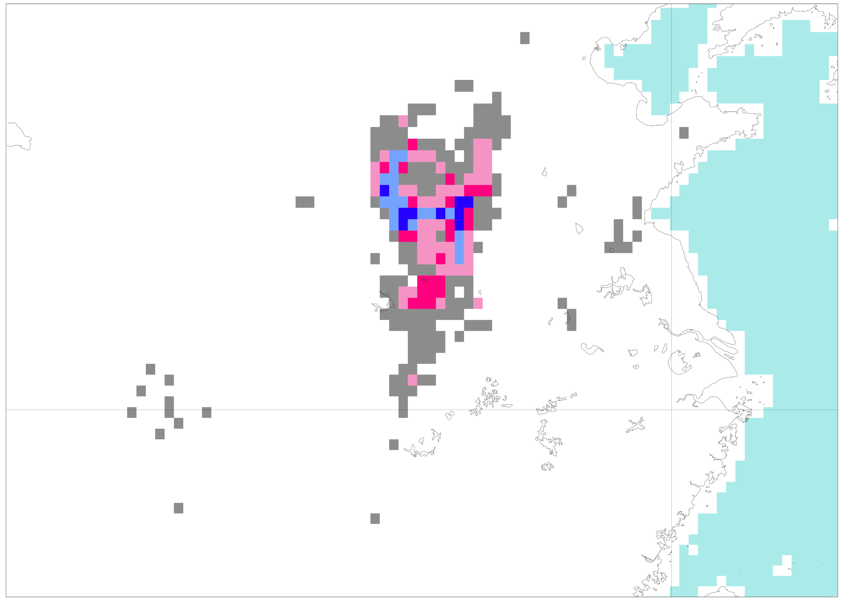
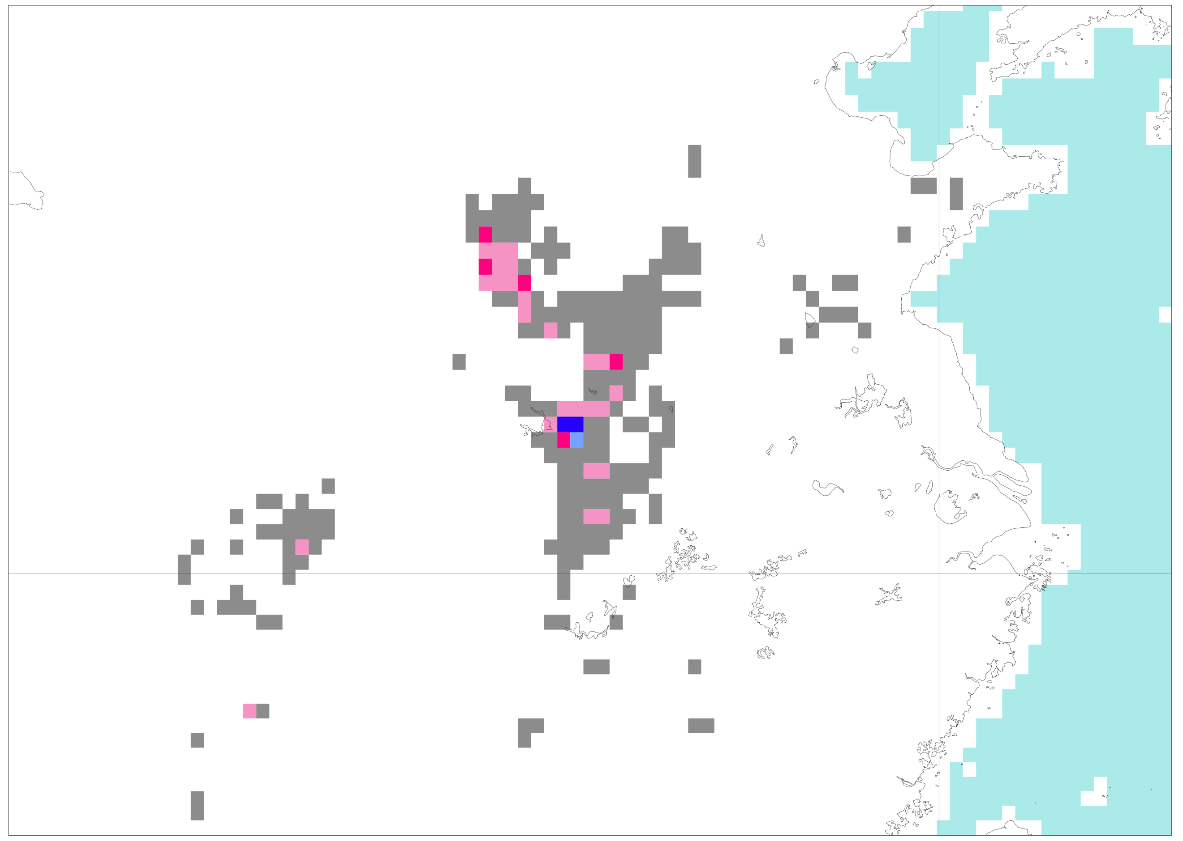
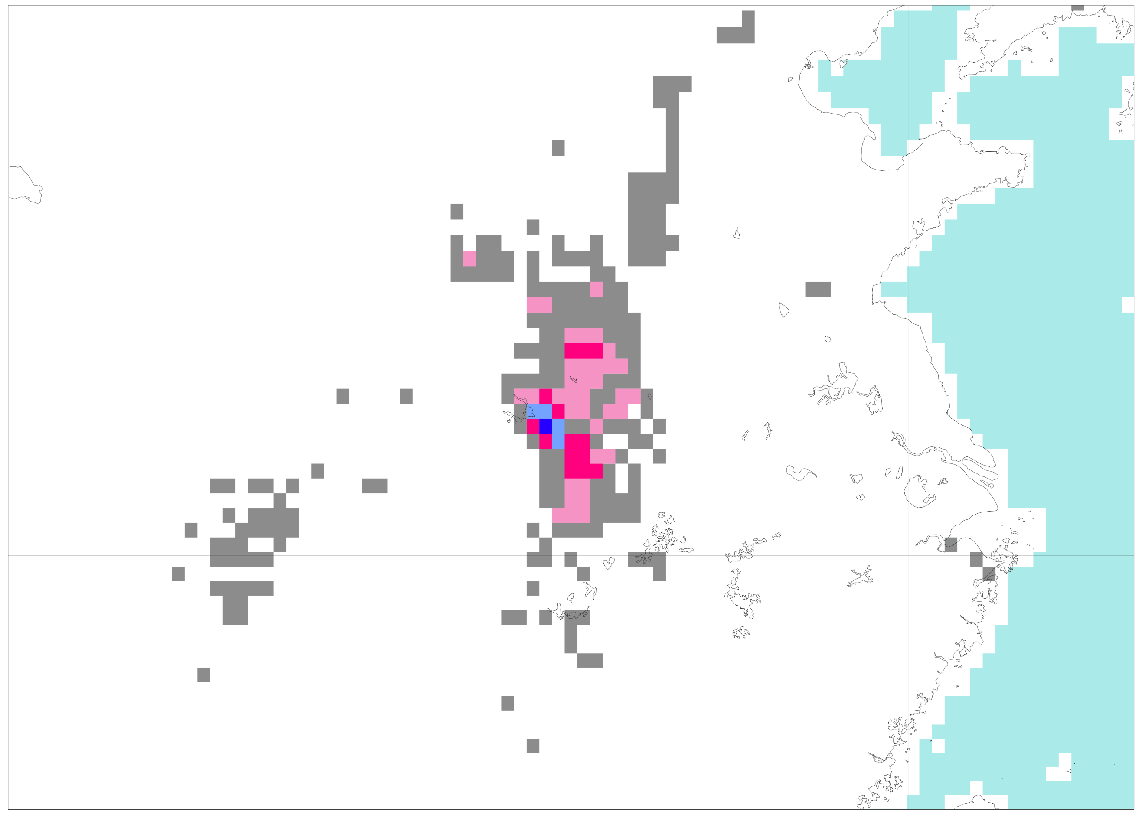
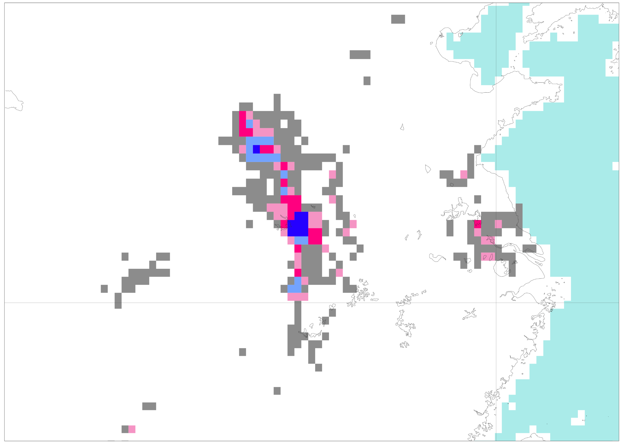
Flash floods in China in July 2021
VT: from 2021-07-20 00 UTC to 2021-07-21 00 UTC
(b) Probability (%)
of exceeding the
1-year return
Period - Reanalysis
100
(a) Rainfall (mm/24h) observations
90.5
80.5
0
70.5
0.5
2
5
10
20
30
40
50
60
80
100
125
150
200
300
500
5000
60.5
50 °N
50.5
40.5
30 °N
35.5
30.5
20 °N
25.5
40 °N
(c) Probability (%)
of exceeding the
50-year return
Period - Reanalysis
20.5
16.5
13.5
10.5
30 °N
8.5
Zhengzhou
624.1 mm/24h
6.5
4.5
30 °N
3.5
20 °N
80 °E
100 °E
120 °E
2.5
20 °N
1.5
80 °E
100 °E
120 °E
0.5
0
Probability (%) of flash flood
0
1
3
5
7
10
25
50
100
d) Reanalysis
e) FC: 2021/07/20 at 00 UTC (t+0,t+24) – Day 1
50 °N
40 °N
40 °N
30 °N
30 °N
20 °N
80 °E
100 °E
120 °E
f) FC: 2021/07/19 at 00 UTC (t+24,t+48) – Day 2
g) FC: 2021/07/18 at 00 UTC (t+48,t+72) – Day 3
40 °N
40 °N
30 °N
30 °N
h) FC: 2021/07/17 at 00 UTC (t72,t+96) – Day 4
i) FC: 2021/07/16 at 00 UTC (t+96,t+120) – Day 5
40 °N
40 °N
30 °N
30 °N
100 °E
120 °E
100 °E
120 °E

